Slide 1
FUTURE IDEAS

Slide 2
IDEA 1
Across languages, there are words with similar intent. For instance, words like “apple, orange etc.” communicate fruit. Words like “great, fantastic, excellent” communicate happiness. Model would learn better if words that communicate similar intent are clustered together. Besides, if we learn a black-box clustering (in some Euclidean space )means that scales across languages where similar words(including their translations) are close together, we just need to train one model finally for all languages using this representation.
Since, we want to perform end-to-end automation of this process, learning a functional form for this clustering would be ideal. ANSWER : NEURAL NETWORKS.

Slide 3
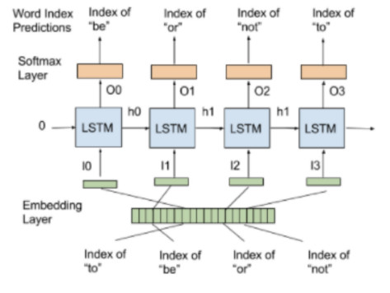
LANGUAGE MODEL
BACKPROPAGATION
How do you train embeddings ?
NNLM
NNLM + Skip-gram connections
RNN(Variants – LSTM, GRU etc.)

Slide 4
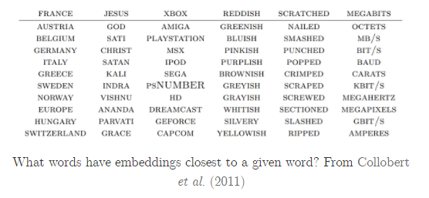
MONOLINGUAL WORD EMBEDDINGS
Pretrained Demo

Slide 5
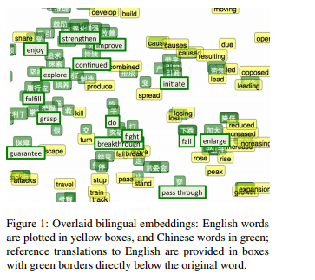
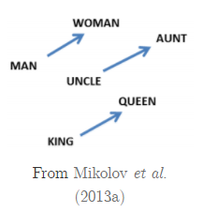
TRANSFER LEARNING - BILINGUAL ALIGNED EMBEDDINGS
Train monolingual embeddings – use fast linear transformations to align them(using bilingual dictionaries)
Train bilingual embeddings online(Translations with Alignment)

Slide 6
Basic Results and Concerns
PRE-TRAINED EMBEDDINGS ISSUES
Fashion Language, Brand Names
Eg : #katewinslet, #katemiddleton, #katetokyo within a small epsilon radius ball. -> Mapped to Unknown.
So, should we train our own embeddings ?
Data Size – particularly in foreign languages.
Solution : Scrape similar social media fashion data.
Cross-Lingual Embedding alignment.

Slide 7
IDEA 2

Slide 8
TRANSFER LEARNING - MODEL TRANSLATION
Key Idea : All languages have underlying similarity in expressing ideas.
The expressed idea is captured as latent variables. So we can think of latent variable transfer across languages.
Idea of Model Translation / Domain Adaptation.
Key Debate : Latent model learning : EXACT INFERENCE vs VARIATIONAL INFERENCE

Slide 9
